Slide 1
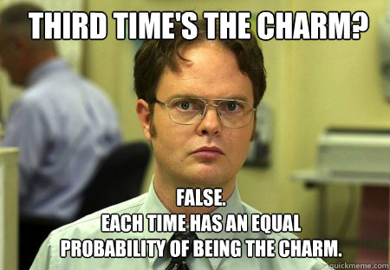

Slide 2
Contents
Glossary or Formula Page
Page
Date
Description
2
3

Slide 3
Tasks
24
7
30
Essential Question
Questions
Notes
Summary
4
5

Slide 4
Warm up
Probability today is a Wednesday?
Probability today is not a Wednesday?
Probability today is either a Wednesday or not a Wednesday?
Probability today is a Wednesday, and also not a Wednesday

Slide 5
24
7
30
Date
Constructing probability tree diagrams
EQ – How does a tree diagram help us calculate the probability of events?
For a coin toss we can have a heads or a tails. What happens if we toss two coins?
5

Slide 6
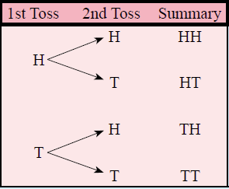

24
7
30
Date
Constructing probability tree diagrams
EQ – How does a tree diagram help us calculate the probability of events?
For a coin toss we can have a heads or a tails. What happens if we toss two coins?
5

Slide 7
24
7
30
Date
Constructing probability tree diagrams
EQ – How does a tree diagram help us calculate the probability of events?
For a coin toss we can have a heads or a tails. What happens if we toss two coins?
5

Slide 8
24
7
30
Date
Constructing probability tree diagrams
EQ – How does a tree diagram help us calculate the probability of events?
For a coin toss we can have a heads or a tails. What happens if we toss two coins?
4 outcomes
Heads then Heads
Heads then Tails
Tails then Heads
Tails then Tails
5

Slide 9
24
7
30
Date
Constructing probability tree diagrams
EQ – How does a tree diagram help us calculate the probability of events?
4 outcomes
Heads then Heads 0.25
Heads then Tails 0.25
Tails then Heads 0.25
Tails then Tails 0.25
5

Slide 10
24
7
30
Date
Constructing probability tree diagrams
EQ – How does a tree diagram help us calculate the probability of events?
4 outcomes
Heads then Heads 0.25
Heads then Tails 0.25
Tails then Heads 0.25
Tails then Tails 0.25
The probability of getting two heads is 0.25
The probability of getting two tails is 0.25
5

Slide 11
24
7
30
Date
Constructing probability tree diagrams
EQ – How does a tree diagram help us calculate the probability of events?
4 outcomes
Heads then Heads 0.25
Heads then Tails 0.25
Tails then Heads 0.25
Tails then Tails 0.25
The probability of getting two heads is 0.25
The probability of getting two tails is 0.25
The probability of getting a heads and a tails (in any order) = ???
5

Slide 12
24
7
30
Date
Constructing probability tree diagrams
EQ – How does a tree diagram help us calculate the probability of events?
4 outcomes
Heads then Heads 0.25
Heads then Tails 0.25
Tails then Heads 0.25
Tails then Tails 0.25
The probability of getting two heads is 0.25
The probability of getting two tails is 0.25
The probability of getting a heads and a tails 0.50
Sum of all outcomes 1.00
5

Slide 13
Activity
You will be given a spot to stand in the room
You need to work out why you are standing there
Notes:
Dark hair, not dark hair
Short hair, long hair
Alternatives: boy / girl, shorts/pants

Slide 14
24
7
30
Date
Constructing probability tree diagrams
EQ – How does a tree diagram help us calculate the probability of events?
Short hair
Long hair
5

Slide 15
24
7
30
Date
Constructing probability tree diagrams
EQ – How does a tree diagram help us calculate the probability of events?
Light hair
Short and Light hair
Short hair
Dark hair
Short and Dark hair
Light hair
Long and Light hair
Long hair
Dark hair
Long and Dark hair
5

Slide 16
24
7
30
Date
Constructing probability tree diagrams
EQ – How does a tree diagram help us calculate the probability of events?
Number
Light hair
Short and Light hair
Short hair
Dark hair
Short and Dark hair
Light hair
Long and Light hair
Long hair
Dark hair
Long and Dark hair
5

Slide 17
24
7
30
Date
Constructing probability tree diagrams
EQ – How does a tree diagram help us calculate the probability of events?
Number
Light hair
Short and Light hair
Short hair
Dark hair
Short and Dark hair
Light hair
Long and Light hair
Long hair
Dark hair
Long and Dark hair
Ex 14.2 p.g. 191, Q1-4
5

Slide 18
Notes Review
24, 7 ,30
Date
Title
Essential question
Notes complete
Notes complete with colour and diagrams
Questions completed
Contents page filed in
Formula page filled in

Slide 19
2-way table
 | Dark hair | Not dark hair | Total
Long hair
Not long hair
Total
Notes:
Only if required to move on to the next topic inside the same session

